Slide 1
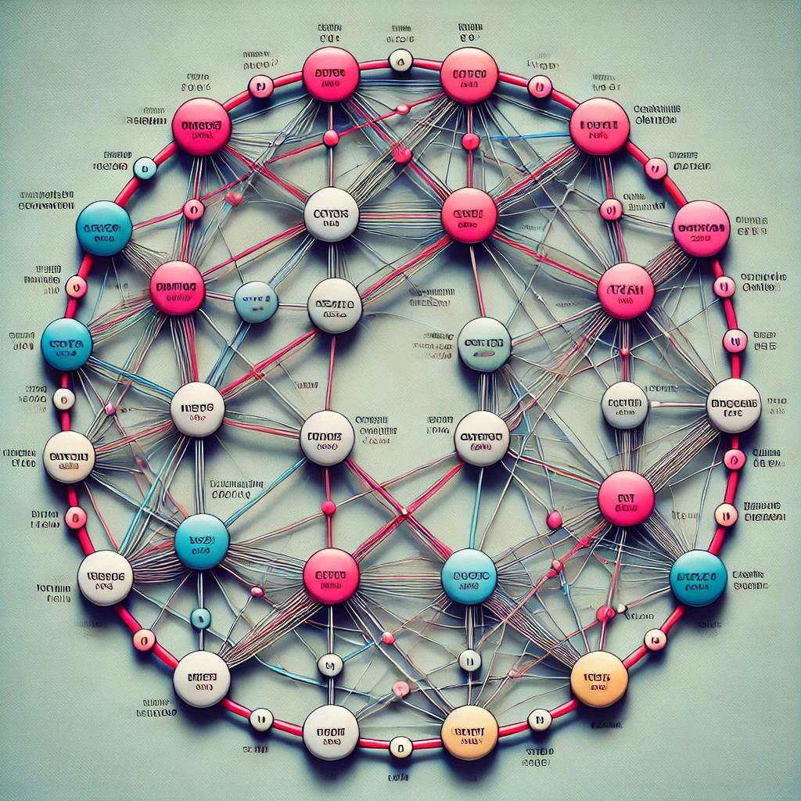
TSP Augmentation
12/9/2024
By: Luke Hennessy

Slide 2
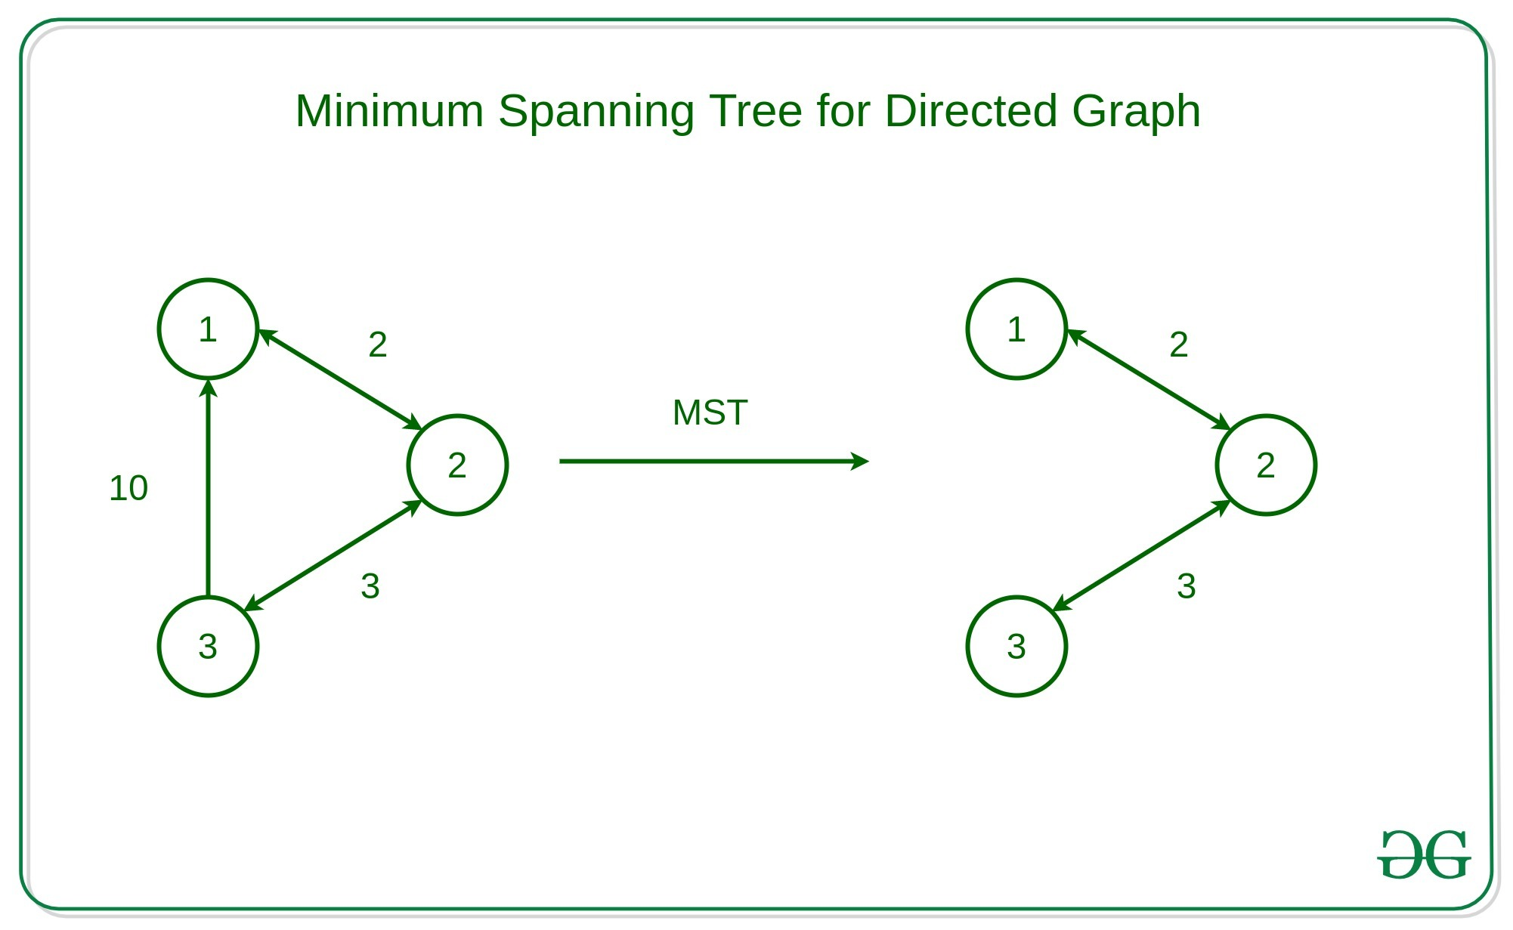
12/9/2024
Minimum Spanning Tree (MST)

Slide 3
12/9/2024
Estimating a Lower Bound
MST as Lower Bound for TSP: MST connects all vertices with the minimum cost and no cycles, while the TSP requires additional constraints like visiting each vertex once and returning to the start.
TSP Cost ≥ MST Cost: The TSP cost is at least as large as the MST cost because it must form a Hamiltonian cycle, which adds extra cost.
Approximation of TSP Return Cost: Adding the least cost edge not in the MST approximates the additional cost of returning to the starting point in the TSP.

Slide 4
12/9/2024
Augment Runtime
Graph Characteristics:
V: Number of vertices
E: Number of edges
Steps and Complexities:
Calculate MST using Prim's Algorithm: O(E log ⁡V)
Extract MST edges: O(V)
Find lightest non-MST edge: O(E)
Key Insight:
Prim's Algorithm dominates the runtime, making the overall complexity: O(E log⁡ V) which is polynomial time computable.

Slide 5
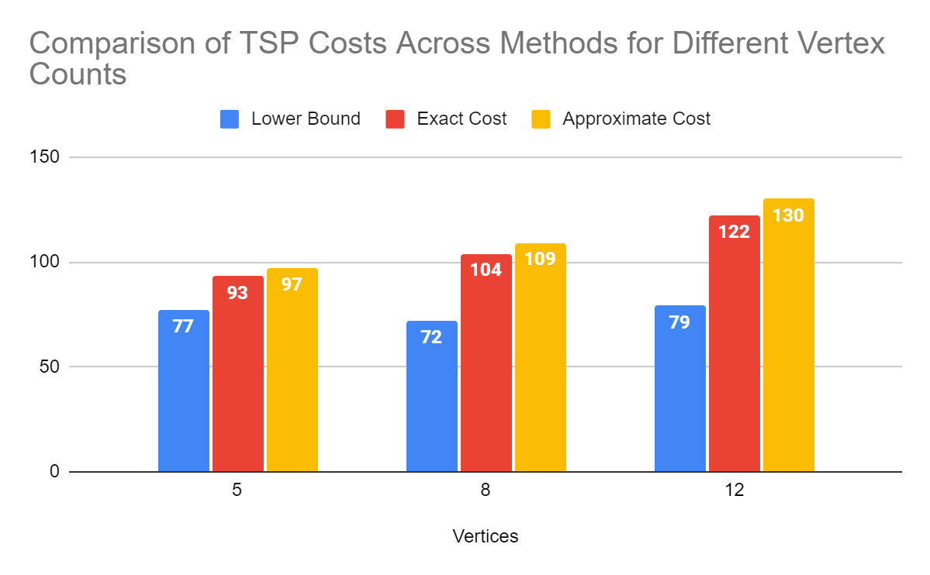
Cost Comparison
Comparative Analysis (Bar Chart)
12/9/2024
Graphs computed with random edge weights in range 1 - 50
Costs shown are averages from 10 runs with the same vertex count

Slide 6
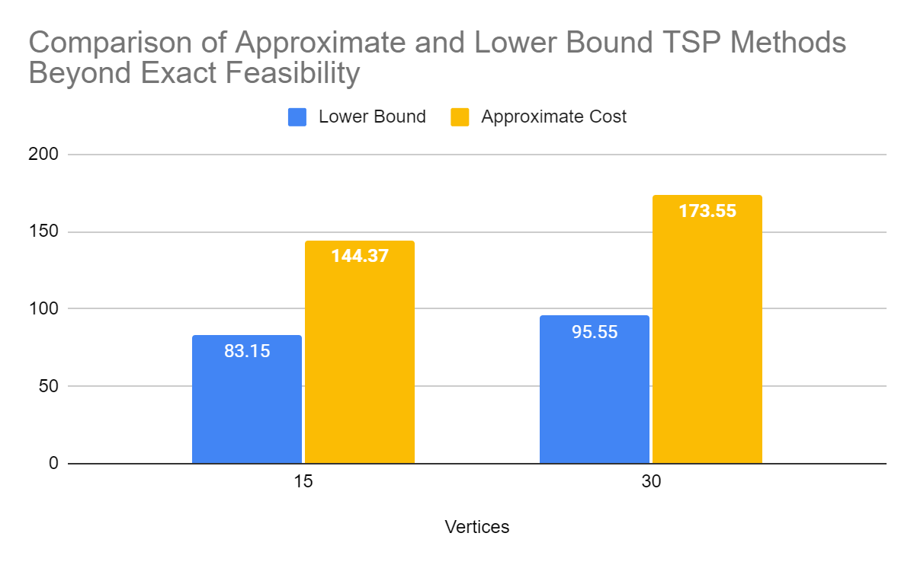
Cost Comparison
Comparative Analysis (Bar Chart)
12/9/2024
Exact Solution runtime > 12 hrs at 15 nodes *Estimation*
Graphs computed with random edge weights in range 1 - 50
Costs shown are averages from 10 runs with the same vertex count

